Slide 1
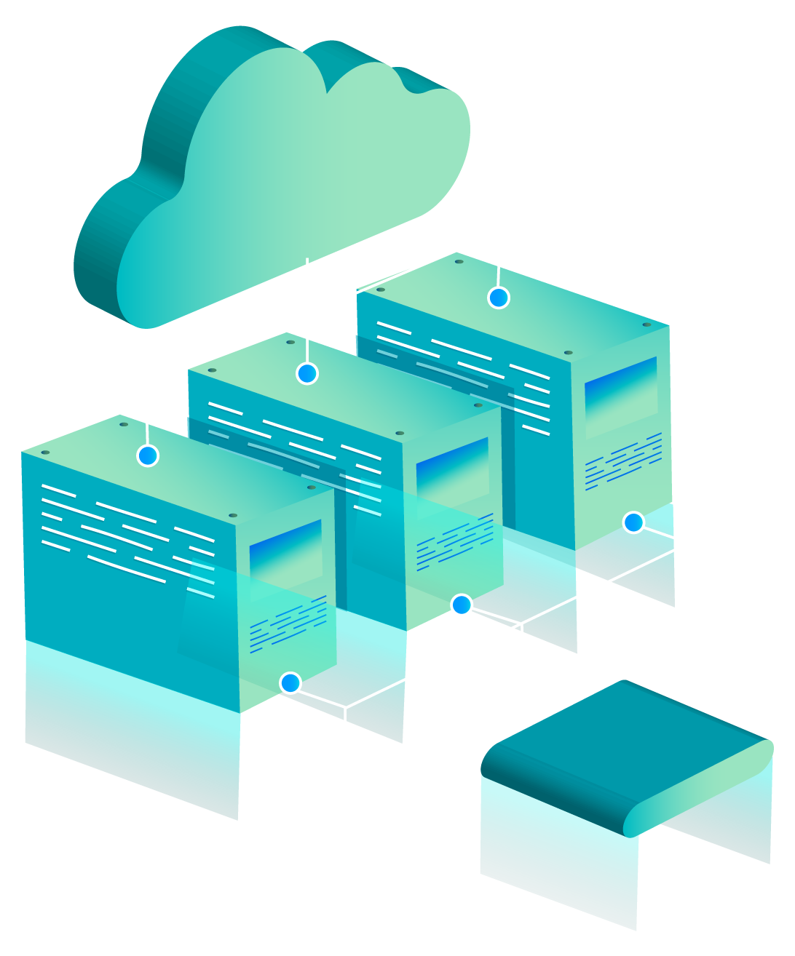
AWS Recommendation System
-Team Aryan

Slide 2
TABLE OF CONTENTS
01
Existing Solutions
03
Architecture Diagram
Overview and Working using Amazon Personalize
02
04
Analysis and Improvements

Slide 3
EXISTING SOLUTIONS
Content recommendation systems are widely used in platforms like Netflix, YouTube, Amazon, and Spotify. These systems leverage machine learning (ML) models to recommend content based on user behavior, item characteristics, and contextual information.
Some of the most popular solutions currently being used for recommendation system implementation are :
Cloud Based : Amazon Personalize , Google Recommendations AI , Azure Personalizer , IBM Watson Discovery etc.
Enterprise-Platform specific : Netflix , Youtube , Linkedin recommendation systems.
Open Source Frameworks & Libraries : Surprise , LightFM , TensorRec
Specialized Platforms & Tools : Algolia Recommend , Qubit , Segment Personas

Slide 4
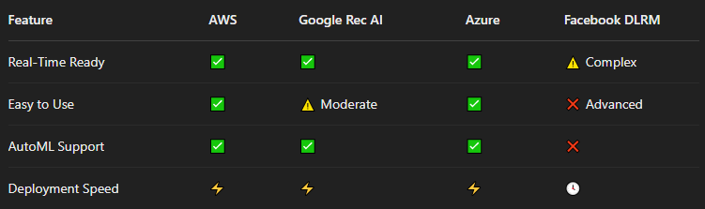
Comparative Analysis of AWS Personalize & Other Cloud Based Models
-

Slide 5
IN DEPTH ANALYSIS OF AWS PERSONALIZE:
Amazon Personalize is a fully managed machine learning service that helps developers create personalized recommendations for users without requiring deep ML expertise. It is commonly used for:
E-commerce (product recommendations)
Media streaming (movie, music recommendations)
News and content platforms
Marketing and advertising
AWS Personalize is built on the same technology that powers Amazon’s recommendation engine, providing businesses with scalable and real-time recommendations.

Slide 6
FEATURES OF AWS PERSONALIZE:
Personalized Recommendations Leverages user behavior, item metadata, and context for tailored suggestions.
Real-Time Inference Delivers low-latency recommendations via APIs for seamless app integration.
Automatic Model Optimization Selects the best ML model and tunes hyperparameters automatically.
Scalable & Managed Infrastructure Fully managed by AWS, auto-scales based on demand—no ML infra management needed.
Easy AWS Integration Integrates with S3, Lambda, API Gateway, SageMaker, CloudWatch, and more.
Multi-Modal Recommendations Offers personalized ranking, similar items, and user-item interactions.
Security & Compliance Provides encryption (at rest & in transit) and IAM-based access control.

Slide 7
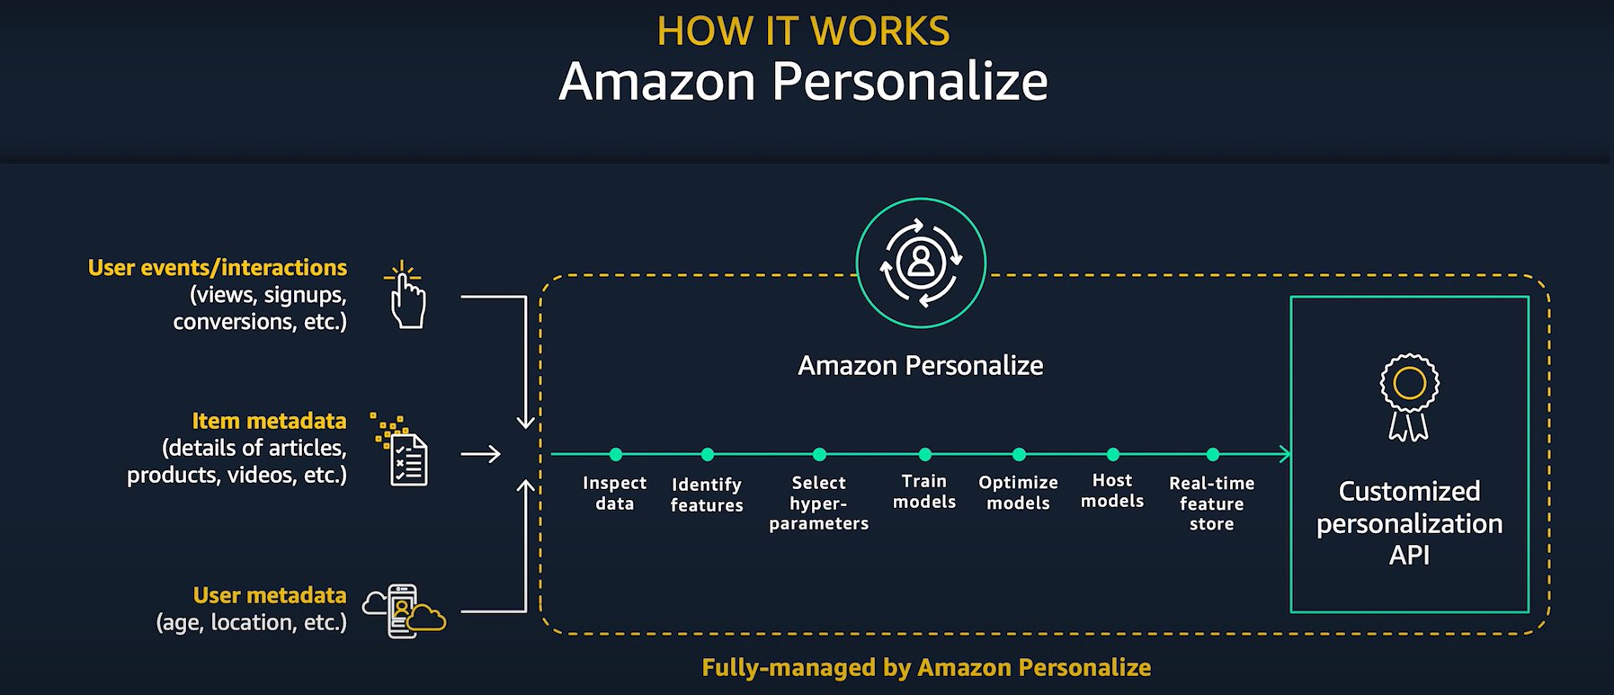

Slide 8
PIPELINE ARCHITECTURE OF AWS PERSONALIZE:
Step 1: Data Collection & Preprocessing
Required Datasets:
Interactions Dataset – Logs user events (clicks, views, purchases).
Items Dataset – Includes metadata like category, price, and description.
Users Dataset (Optional) – Contains user attributes (age, location, preferences).
Storage: Data is uploaded to Amazon S3 and imported into AWS Personalize.
Step 2: Data Schema Definition
Define a JSON-based schema to structure the datasets.
Ensures AWS Personalize interprets the data correctly.
Step 3: Model Training (Solution Creation)
AWS Personalize:
Auto-selects the best ML algorithm.
Uses AutoML for hyperparameter optimization.

Slide 9
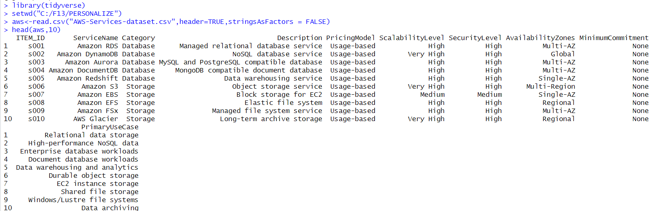
AWS SERVICES CATALOG GATASET

Slide 10
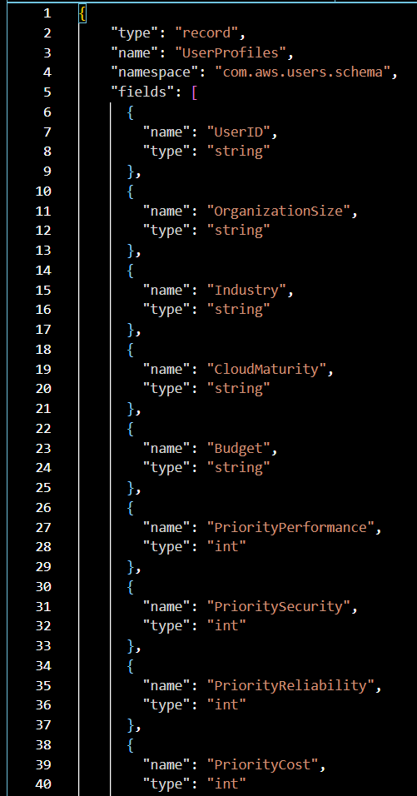
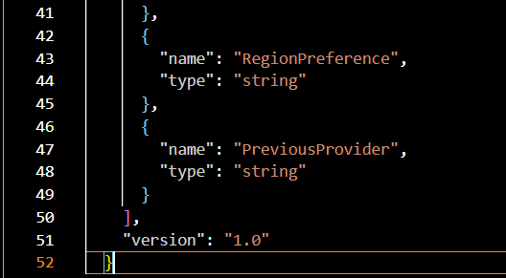
AWS-Services-Catalog Dataset
JSON Schema Definition

Slide 11
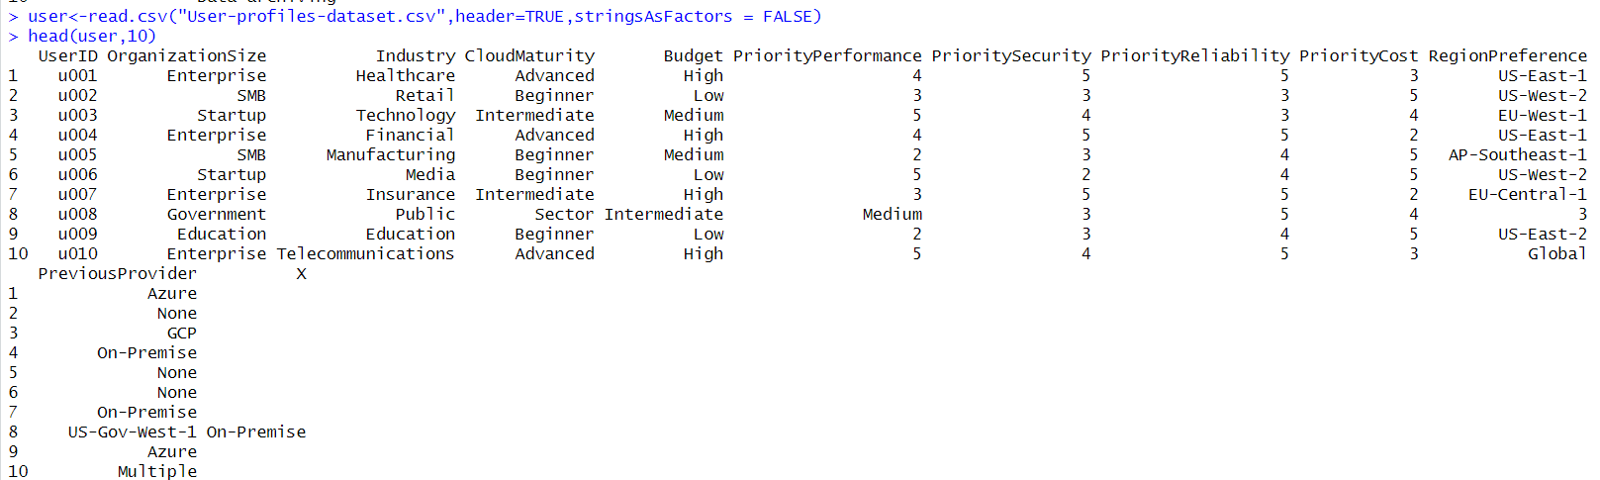
USER PROFILES DATASET

Slide 12
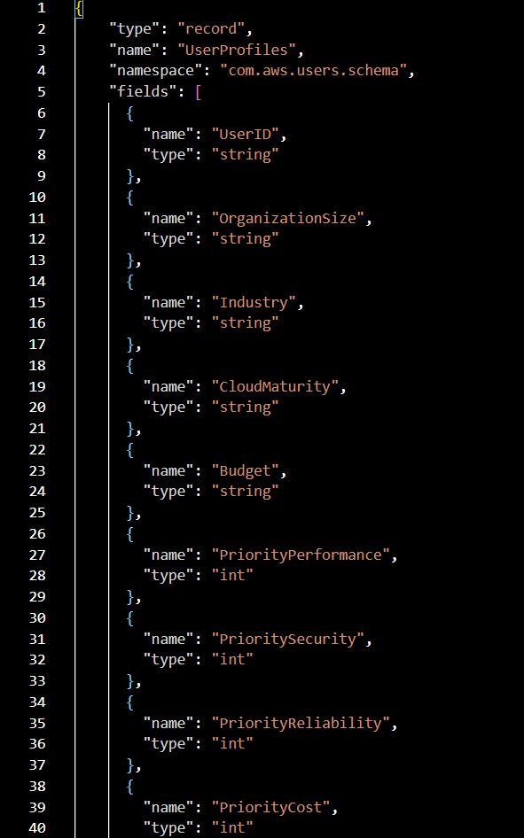
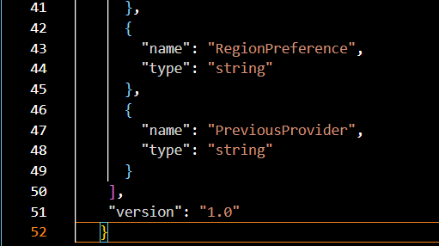
User-Profile Dataset JSON Schema Definition

Slide 13
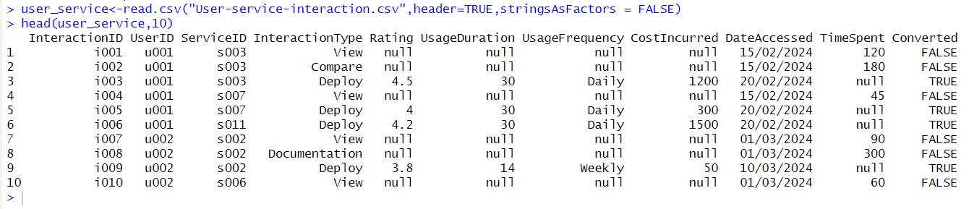
USER-SERVICES DATASET

Slide 14
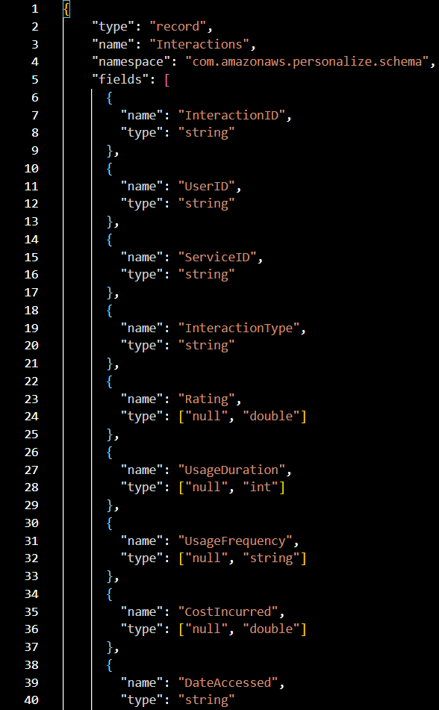
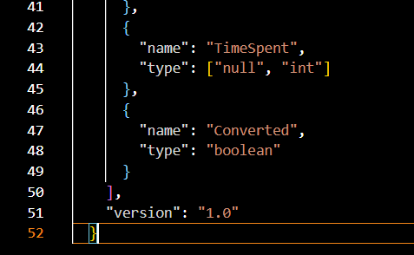
User-Service Interaction Dataset JSON Schema Definition

Slide 15
PIPELINE ARCHITECTURE OF AWS PERSONALIZE:
Step 4: Deploying a Campaign
After training, create a Campaign to deploy the model.
Campaigns manage real-time inference and serve recommendations via API.
Step 5: Getting Recommendations
Use Personalize Runtime API to retrieve personalized results.
Easily integrate recommendations into web or mobile applications.
Step 6: Continuous Improvement
Continuously import new data to retrain models.
Regular updates improve model accuracy and relevance over time.

Slide 16
ALGORITHMS EMPLOYED IN AWS PERSONALIZE:
User-Personalization (Default)
Uses deep learning to analyze user behavior
Learns user preferences for personalized ranking
Popularity-Count
Ranks most popular items (non-ML)
Ideal for cold-start situations
Personalized-Ranking
Reorders items based on user’s past interactions
Great for personalized search results
Similar-Items
Recommends items similar to a selected one
Based on item metadata (content-based filtering)
Custom Recipes
Import custom ML models via Amazon SageMaker
For advanced, tailored recommendation logic

Slide 17
EFFECTIVENESS OF AWS PERSONALIZE:
Performance & Accuracy
Uses advanced deep learning for high accuracy
Learns from user interactions in real time
Offers context-aware recommendations (e.g., based on location, device)
Scalability
Handles millions of users and items
Auto-scales with AWS—great for growing apps
Cost & Pricing
Pay-as-you-go model
Charges based on:
Data ingestion & storage
Model training
Real-time recommendations
Flexibility
Fast setup with pre-built models—no ML expertise needed
Supports custom models via Amazon SageMaker

Slide 18
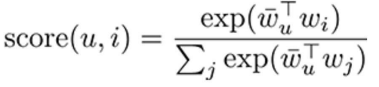
AWS Personalize – Ranking Algorithm
After creating or updating a campaign, you can:
Get recommendations for a user
Find similar items
Rerank a list of items for a user
How it works:
Each item is given a score between 0 and 1
Scores are relative and sum up to 1 for each user
Example: For 3 movies, scores might be 0.6, 0.3, 0.1
Interpretation:
Higher score = more relevant for that user
With thousands of items, individual scores will be small—focus on the ranking, not absolute value
Behind the scenes:
Uses HRNN (Hierarchical Recurrent Neural Network)
Calculates scores using user-item embeddings
Measures how well a user matches an item via a dot product

Slide 19
OVERVIEW OF THE RECOMMENDATION SYSTEM
The project focuses on building a personalized recommendation system using Amazon Personalize, a machine learning service by AWS that allows developers to deliver real-time personalized user experiences with minimal ML expertise.The project focuses on building a personalized recommendation system using Amazon Personalize, a machine learning service by AWS that allows developers to deliver real-time personalized user experiences with minimal ML expertise.
Core Objectives:
Deliver accurate and dynamic product or content recommendations
Handle large-scale datasets with real-time personalization
Overcome cold-start challenges and data limitations

Slide 20
PURPOSE AND SIGNIFICANCE
PURPOSE:
To deliver personalized product/content suggestions based on user behavior
Enhance user engagement and satisfaction through relevant recommendations
Reduce decision fatigue by automating content discovery
Improve conversion rates in platforms like e-commerce, media, and learning systems
SIGNIFICANCE:
Uses real-time learning to adapt to evolving user preferences
Eliminates need for in-depth ML knowledge via AutoML and pre-built models
Scalable to millions of users/items with minimal latency
Addresses common industry challenges like cold start and data sparsity
Applicable across multiple domains: retail, entertainment, education, and more

Slide 21
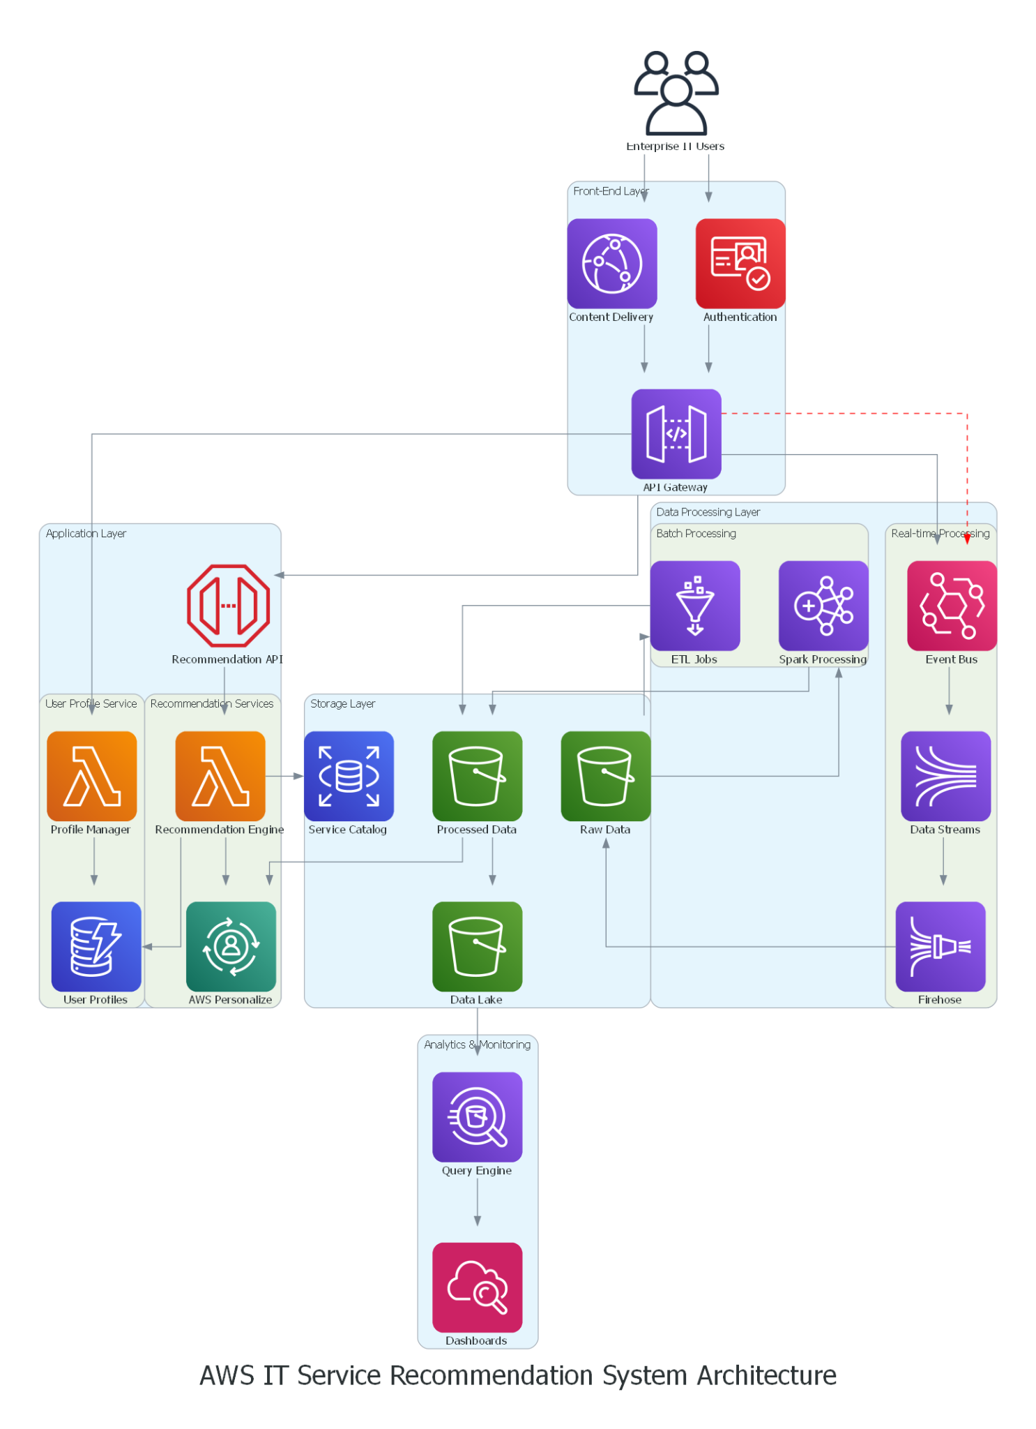
Proposed AWS Architecture Diagram
Follows Multi-Layered Architecture :
Front-end (UI) Layer
Application Layer
Data Processing Layer
Storage Layer
Analytics and Monitoring Layer
Integration and Flow Services

Slide 22
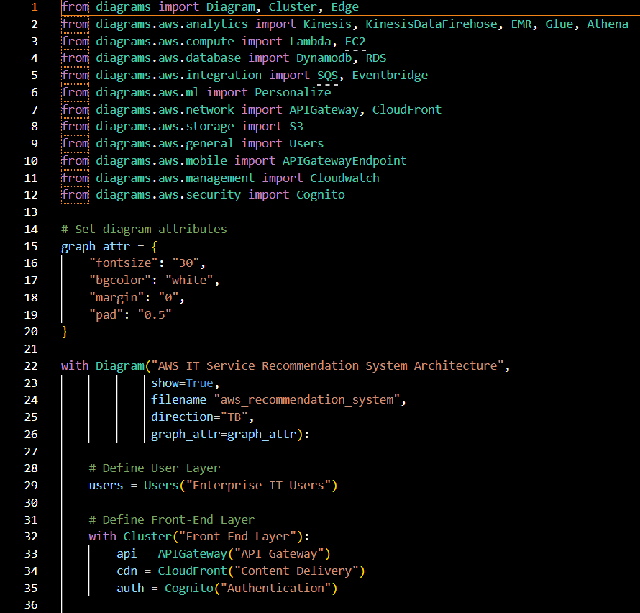
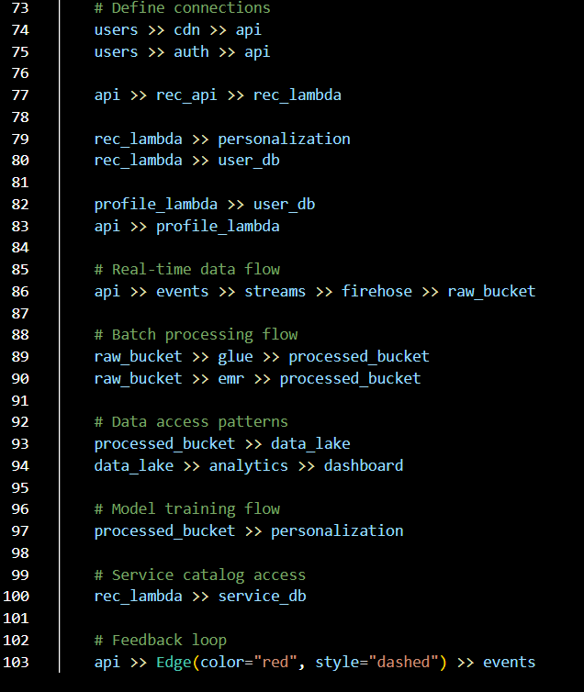
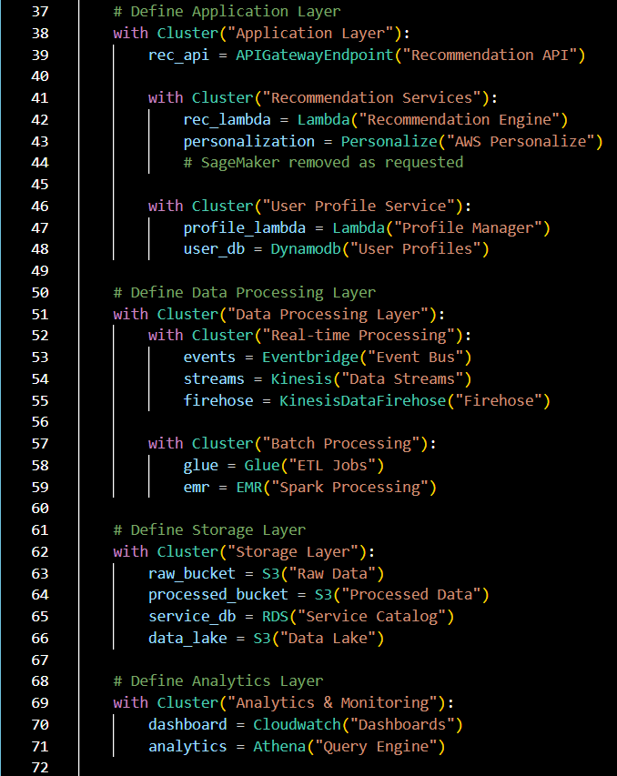
Architecture Diagram As Code

Slide 23
ARCHITECTURE DIAGRAM ANALYSIS
Front-End Layer
API Gateway
Purpose: Provides a unified entry point for all API calls
Why: Manages API versioning, throttling, authentication, and creates a secure facade for backend services
CloudFront
Purpose: Content delivery network for static assets
Why: Reduces latency by caching content at edge locations globally, improving user experience
Cognito
Purpose: Authentication service
Why: Provides secure user authentication, authorization, and user management capabilities
Application Layer
API Gateway Endpoint (Recommendation API)
Purpose: Dedicated endpoint for recommendation services
Why: Separates recommendation traffic for better management and scaling
Lambda (Recommendation Engine)
Purpose: Serverless compute for recommendation logic
Why: Provides cost-effective, scalable compute that only runs when needed
Personalize
Purpose: ML-based recommendation service
Why: Offers managed ML capabilities specifically designed for personalization without needing to build custom ML infrastructure
Lambda (Profile Manager)
Purpose: Handles user profile operations
Why: Processes user data updates and interactions in a serverless manner
DynamoDB (User Profiles)
Purpose: NoSQL database for user data
Why: Provides millisecond response times and automatic scaling for user profile storage

Slide 24
ARCHITECTURE DIAGRAM ANALYSIS
Data Processing Layer
EventBridge
Purpose: Event bus for system events
Why: Facilitates decoupled architecture by routing events between components
Kinesis Data Streams
Purpose: Real-time data streaming
Why: Captures and processes high-volume user interaction data in real-time
Kinesis Data Firehose
Purpose: Data delivery stream
Why: Automatically loads streaming data into S3 with minimal configuration
Glue
Purpose: ETL (Extract, Transform, Load) service
Why: Manages data cataloging and transformation jobs for structured data processing
EMR (Elastic MapReduce)
Purpose: Managed Hadoop/Spark cluster
Why: Handles complex data processing and analysis tasks that require distributed computing
Storage Layer
S3 (Raw Data)
Purpose: Object storage for raw incoming data
Why: Provides durable, scalable storage for unprocessed data before transformation
S3 (Processed Data)
Purpose: Object storage for processed data
Why: Stores transformed and enriched data ready for analysis and model training
RDS (Service Catalog)
Purpose: Relational database for service information
Why: Maintains structured data about available IT services with ACID compliance
S3 (Data Lake)
Purpose: Centralized repository for all data
Why: Consolidates data from various sources for comprehensive analytics

Slide 25
ARCHITECTURE DIAGRAM ANALYSIS
Analytics & Monitoring Layer
CloudWatch
Purpose: Monitoring and observability
Why: Provides metrics, logs, and dashboards to monitor system health and performance
Athena
Purpose: Serverless query service
Why: Enables SQL queries directly against data in S3 without moving the data
Integrations and Flow Services
SQS (included in imports but not explicitly shown in the diagram)
Would typically be used for message queuing to decouple and buffer operations

Slide 26

RESULT ANALYSIS & PERFORMANCE

Slide 27
SCALABILITY ANALYSIS
Strong Points
Serverless Components: The extensive use of Lambda functions, API Gateway, and other serverless technologies allows the system to scale automatically based on demand.
Distributed Data Processing: The separation between real-time (Kinesis) and batch processing (EMR, Glue) allows for different scaling approaches based on workload patterns.
Content Delivery Network: CloudFront integration ensures global scalability for static content with low latency.
Managed Services: AWS Personalize handles the complex ML workloads and scales as needed without manual intervention.
Potential Concerns
DynamoDB Scaling: While DynamoDB scales horizontally, proper provisioning of read/write capacity is needed to avoid throttling during peak usage.
RDS Bottlenecks: The Service Catalog in RDS could become a bottleneck as it doesn't scale as seamlessly as other components in the architecture.

Slide 28
PERFORMANCE ANALYSIS
Strong Points
Real-time Processing: The Kinesis data stream enables real-time data processing for immediate feedback.
Caching Layer: CloudFront provides edge caching to reduce latency for frequent requests.
Separation of Concerns: The clear division between recommendation and profile services allows for optimized performance tuning for each workload type.
Personalize Integration: AWS Personalize provides high-performance ML-based recommendations without the overhead of managing ML infrastructure.
Potential Concerns
Cross-Service Latency: Multiple service hops (like API Gateway → Lambda → DynamoDB → Personalize) could introduce cumulative latency.
Cold Starts: Lambda functions may experience cold starts if traffic patterns are irregular.

Slide 29
COST OPTIMIZATION
Strong Points
Serverless Pay-per-use: Lambda, API Gateway, and other serverless components only incur costs when in use.
Data Lifecycle Management: The flow from raw to processed to data lake suggests proper data lifecycle management, potentially using S3 lifecycle policies to reduce storage costs.
Right-sizing for Workloads: Using EMR for batch processing and Kinesis for streaming allows cost optimization for different data processing needs.
Potential Concerns
Personalize Costs: AWS Personalize can be expensive, especially with continuous training and high request volumes.
Data Transfer Costs: Multiple data movements across services could incur significant data transfer costs.
RDS Provisioning: The RDS instance needs careful capacity planning to avoid over-provisioning.

Slide 30
SECURITY ANALYSIS
Strong Points
Authentication Layer: Cognito provides robust identity management and authentication
API Protection: API Gateway offers request validation, throttling, and authorization
Service Separation: Clear service boundaries minimize the blast radius of potential breaches
Event-Based Architecture: EventBridge enables secure communication between components
Potential Concerns
Secrets Management: No visible secrets management solution (AWS Secrets Manager/Parameter Store)
Container Security: If containers are used, additional security measures would be needed
Data Classification: No indication of data classification or differential protection

Slide 31
COMPLIANCE AND GOVERNANCE
Strong Points
Data Lake Structure: Organized data flow facilitates audit and compliance reporting
Monitoring Framework: CloudWatch enables comprehensive logging for audit trails
User Authentication: Cognito supports compliance requirements for user access
Potential Concerns
Regulatory Requirements: No specific accommodations for industry regulations visible
Data Residency: No clear strategy for data sovereignty or multi-region requirements
Retention Policies: No explicit data retention and purging mechanisms shown

Slide 32
OPERATIONAL EXCELLENCE
Strong Points
Monitoring Dashboard: CloudWatch dashboards for operational visibility
Managed Services: Reduced operational overhead through AWS managed services
Real-time Processing: Ability to react quickly to system events
Potential Concerns
Alerting Framework: No explicit alerting strategy visible
Runbook Integration: No indication of operational procedures documentation
Chaos Engineering: No visible approach to proactive resilience testing

Slide 33

AWS
INSIGHT GAINED
Ease of Use: No ML expertise required due to AutoML, built-in recipes, and schema-based setup.
High Flexibility: Can switch between popularity-based, personalized, or similar item algorithms.
Cost vs Performance Trade-off: Real-time recommendations are powerful but may incur high costs for large-scale deployments.
Cold Start Mitigation: Popularity-count and metadata-based recommendations help handle new users/items.
Continuous Improvement: Feedback loop ensures recommendation accuracy improves over time.

Slide 34
CHALLENGES & SOLUTIONS

Slide 35
AWS
ISSUES FACED DURING DEVELOPMENT
Ensuring correct data format and schema
Handling the cold start problem (new users/items)
Long model training times
Limited customization of algorithms
Managing costs with scaling and real-time usage
Monitoring model performance and tuning

Slide 36
AWS
STRATEGIES USED TO OVERCOME THEM
Used AWS schema templates and validators for data formatting
Applied popularity-based and item metadata for cold start issues
Performed testing with small datasets; trained during off-peak hours
Leveraged built-in AWS recipes (HRNN, SIMS) for different use cases
Monitored usage with AWS Cost Explorer and applied budget alerts
Continuously retrained with updated interaction data for better accuracy

Slide 37
FUTURE ENHANCEMENTS

Slide 38
AWS
IMPROVEMENTS
Caching Strategy: Implement DAX for DynamoDB and consider adding ElastiCache to reduce repeated database calls.
Reserved Capacity: For predictable workloads, consider reserved capacity for services like RDS and DynamoDB to reduce costs.
Multi-AZ and Multi-Region: Consider implementing Multi-AZ for critical components and potentially Multi-Region for disaster recovery.
Cost Monitoring: Add AWS Cost Explorer and Budget alerts to proactively manage costs.
Performance Monitoring: Enhance CloudWatch monitoring with custom metrics and X-Ray for distributed tracing.
Auto-archiving: Implement S3 Intelligent-Tiering or lifecycle policies to automatically move older data to cheaper storage tiers.

Slide 39

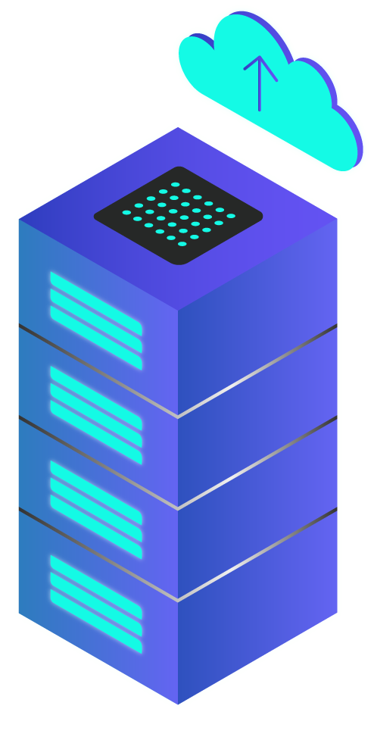
CONCLUSION
Summary of key takeaways

Slide 40

KEY TAKEAWAYS
Real-Time & Scalable Recommendations
No ML Expertise Required
Effective Cold Start Solutions
Addressed Development Challenges
Support for Multiple Algorithms (HRNN, SIMS)
Continuous Model Improvement via Feedback Loops
Scope for Customization & Multi-Platform Expansion

